Slide 1
Unit 5
On the farm
Lesson 1 and 2

Slide 2
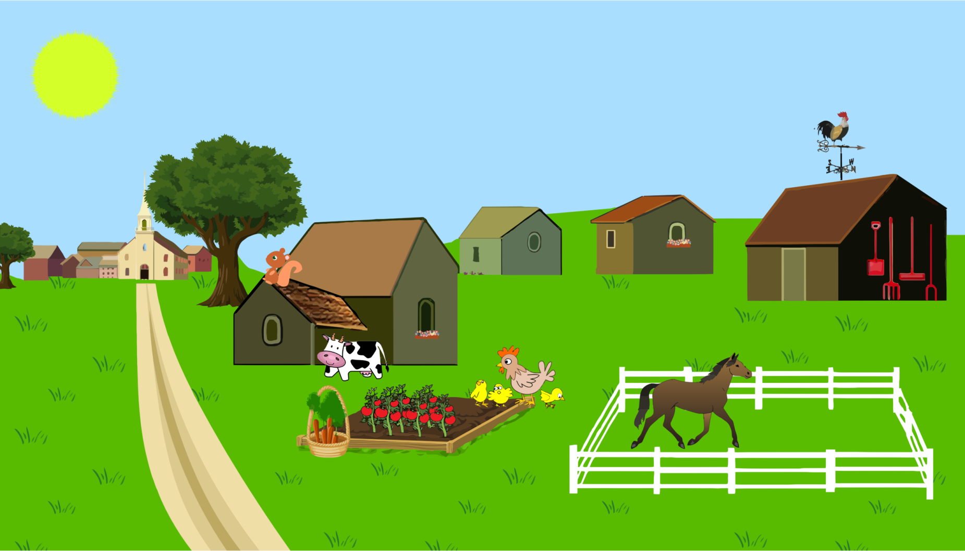
farm

Slide 3
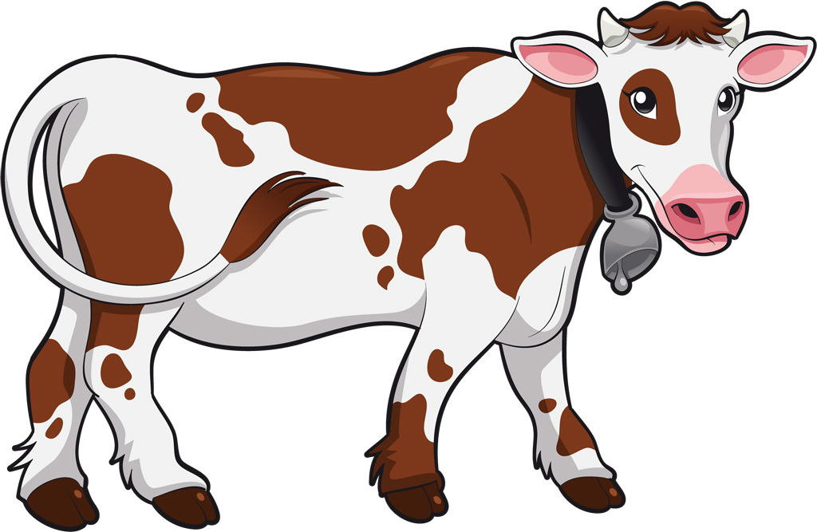
cow

Slide 4
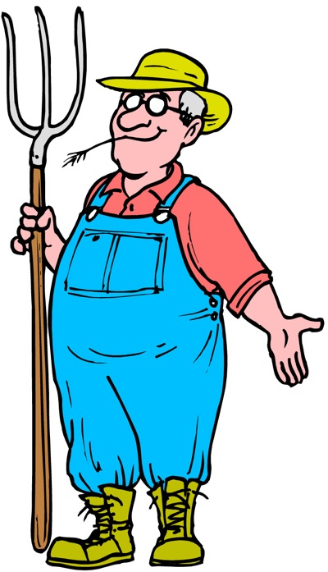
farmer

Slide 5
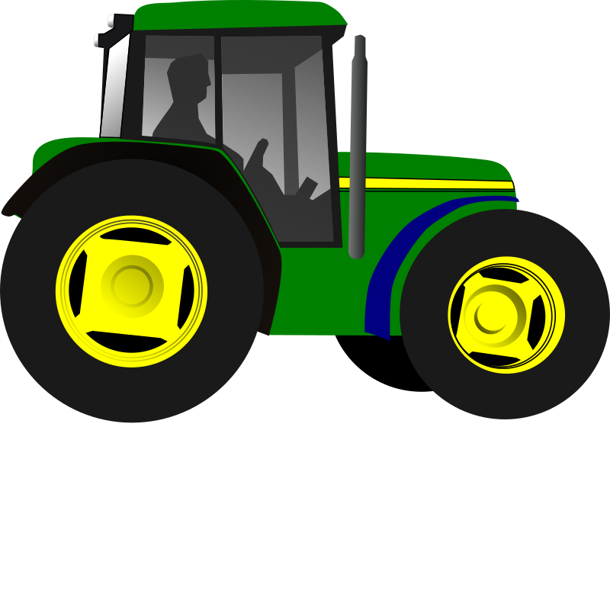
tractor

Slide 6
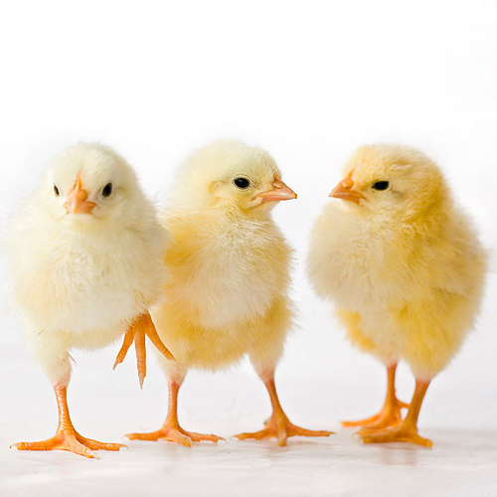
chicks

Slide 7
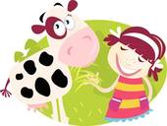
Feeding the cow

Slide 8
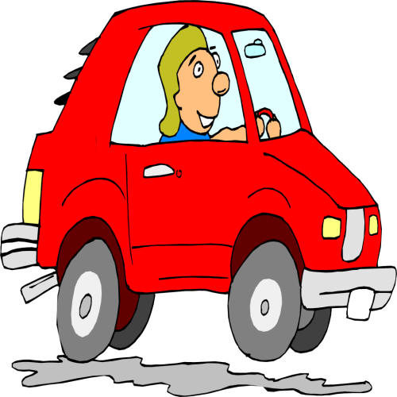
driving

Slide 9
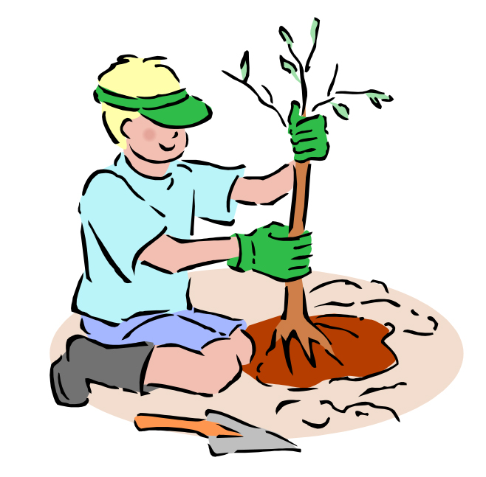
planting

Slide 10
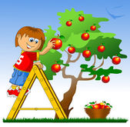
picking

Slide 11
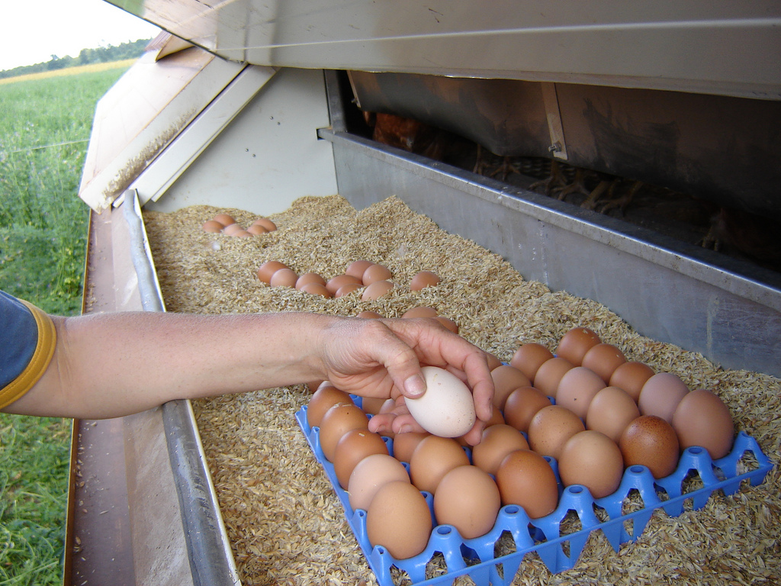
Collecting eggs

Slide 12
What is the girl doing ?

Slide 13
Read the words
cow
Tractor
Field
Chicks
farmer

Slide 14
Read the following sentences
Feeding the cow
Collecting apples
Planting a tree
Driving a tractor

Slide 18
activity book
75

Slide 20
activity book
76

Slide 21
He is feeding a hen.
They are feeding the horse.

Slide 22
Unit 5
On the farm
Lesson 3

Slide 23
There is a brown cow

Slide 24
There are brown cows

Slide 25

There is a pink horse

Slide 26
There are pink horses

Slide 28
activity book
77

Slide 29
are yelllow
Is a pink sheep
is a blue horse

Slide 30
Unit 5
On the farm
Lesson 4

Slide 31
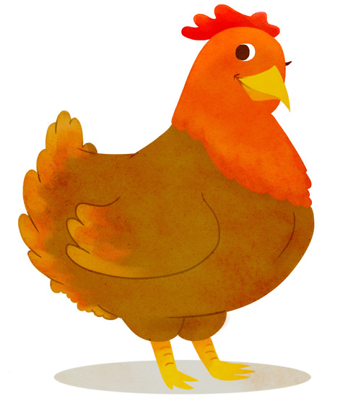
The life cycle of a hen

Slide 32
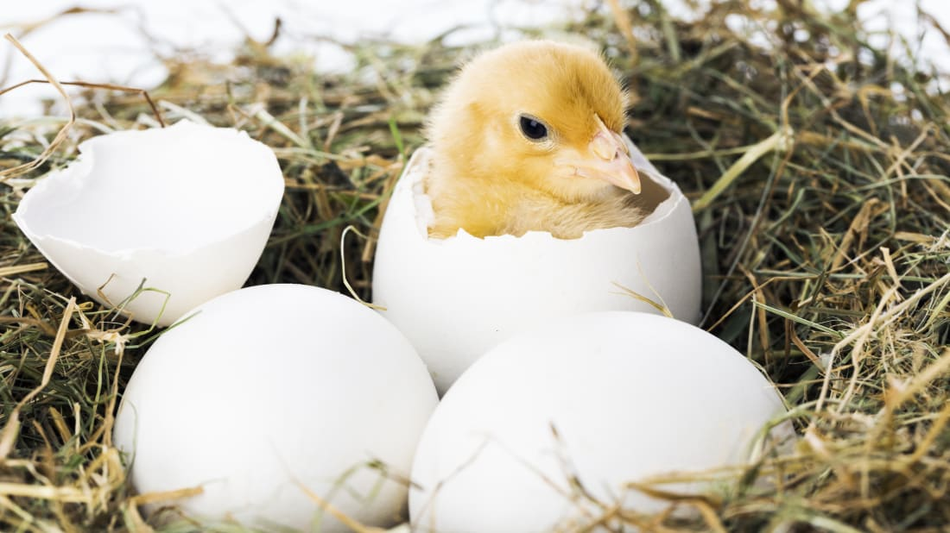
A chick grows inside the egg

Slide 33
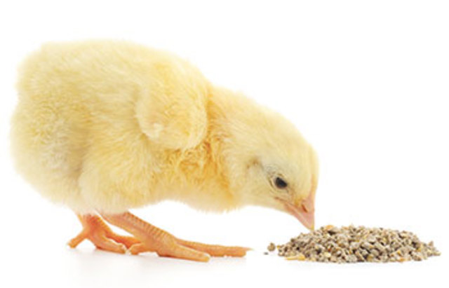
The chick eats

Slide 34
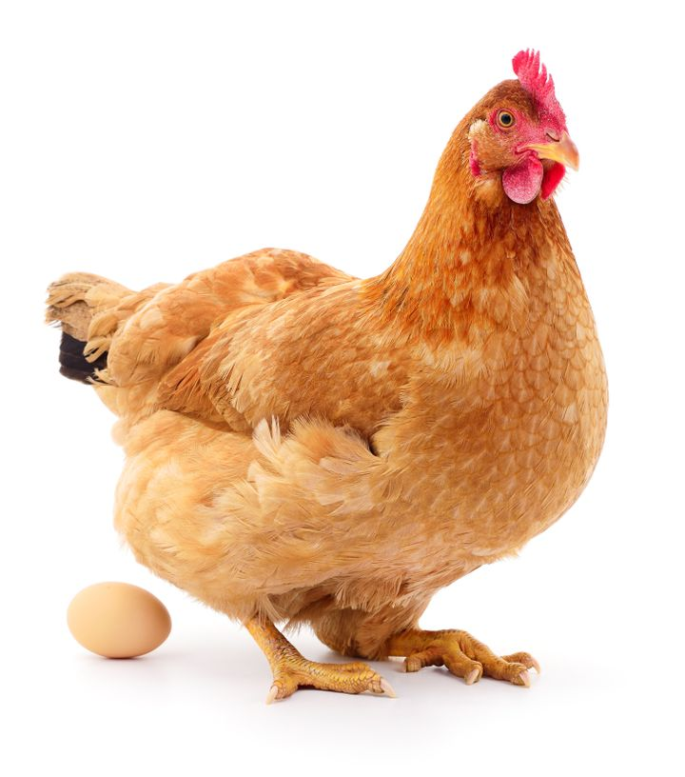
The hen lays an egg

Slide 36
activity book
78

Slide 37
e g g s
h e n
c h i c k

Slide 38
grows
1
lays
3
2
eats

Slide 39
Unit 5
On the farm
Lesson 5

Slide 40
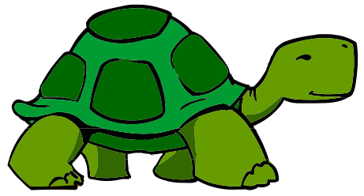
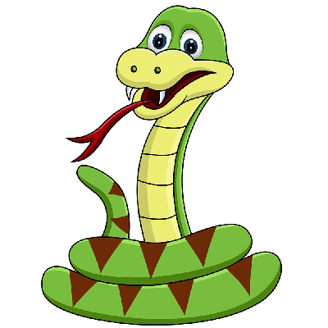
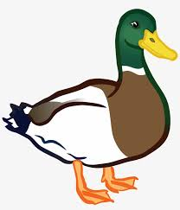
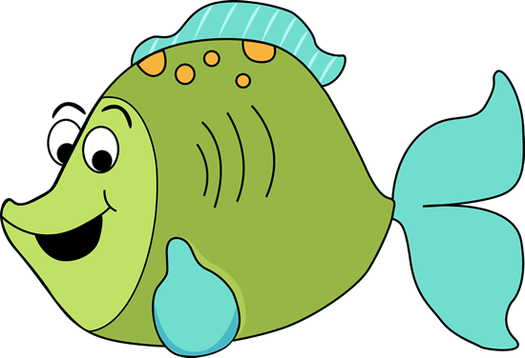
Animals lay eggs

Slide 41
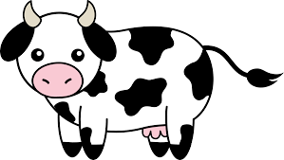

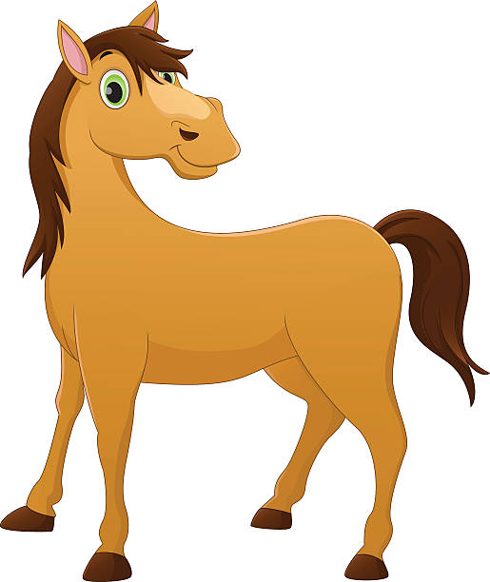
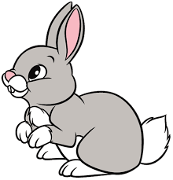
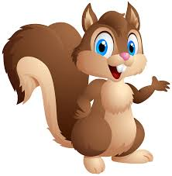
Animals don't lay eggs

Slide 43
activity book
77

Slide 44
fish
duck
turtle
snake
cow
tiger
rabbit
squirrel

